Slide 1

Key Note NPP Submission
Bryan Swan – Team OpenGov

Slide 2

Code Used
HTML5, JavaScript, CSS
No extensions or plugins are used. The display page uses jQuery, but that is merely to present judges with links to the HTML pages in an easy to peruse fashion.
All code use was checked for open source attributes

Slide 3

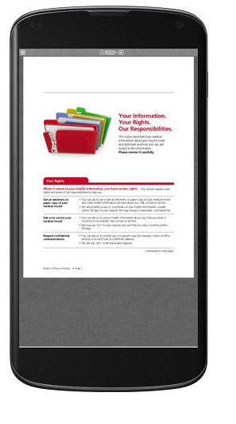
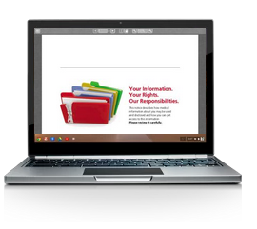
Mobile & Responsive Capable

Slide 4
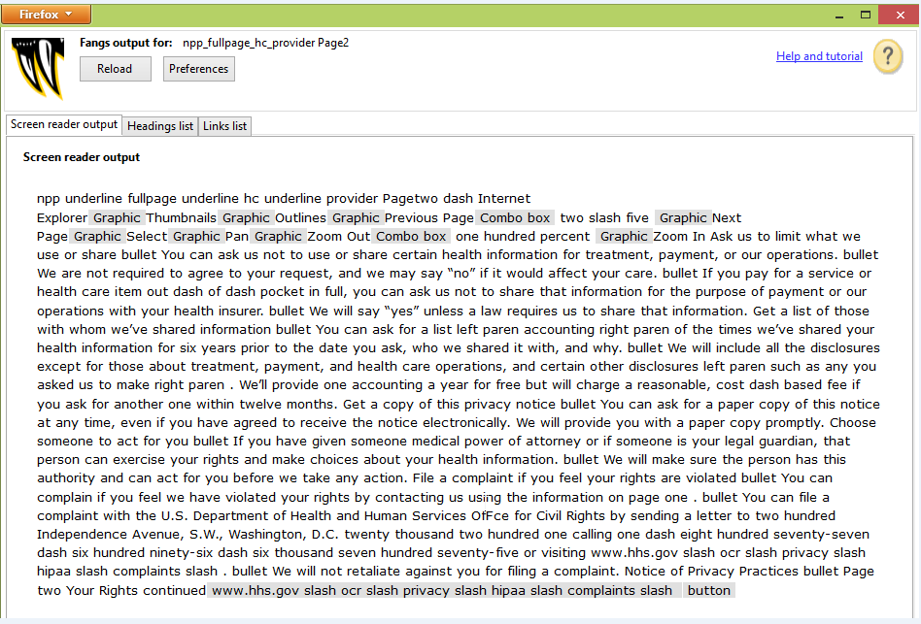
Tested 508 Compliant

Slide 5
Implementation
Firm takes the folders and deploys them to their webserver after customizing the message boxes per the PDFs
Firm deploys text or icon hyperlinks on their home page respective HTML documents to meet federal guidelines

Slide 6
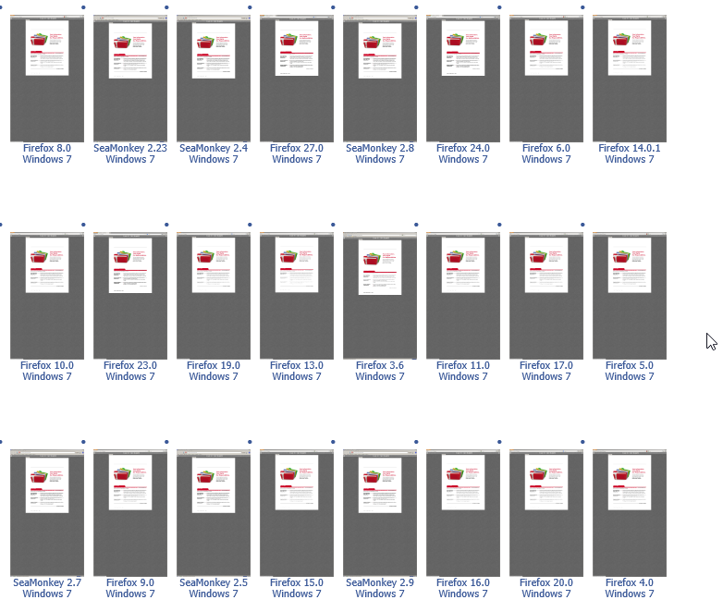
Works on All Browsers and OS

Slide 7
Minimum Hardware
1 GB RAM (2 GB recommended)
Windows XP with Service Pack 3
40 GB hard drive with at least 15% free space

